Slide 1
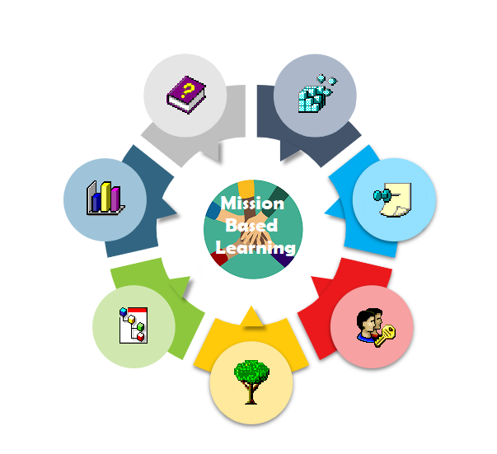
Mission-Based Learning Fashion and identity
Bauskas pilsetas pamatskola

Slide 2
The story so far…
Our plan was to educate our school about fashion, so next week (December 5-10) we will have a fashion week, as well as during our art classes we created costumes with latvian signs in a modern way.

Slide 3
What actually happened…
Planning our missions: we decided we would do as much as we can together because this is a group project, but of course some things you can’t do together like making your own costume.
Challenges: Of course the biggest challange was Covid-19 because most of the time we weren’t studying in person but at home so we couldn’t really do a lot of the things we planned. Other challange was that we are the eldest class in our school so that means we have to get ready for exams and we have a lot of tests and homework

Slide 4
Storyline
Filming videos about school struggles
We decided to change our mission after realising how important self identity actually is.
<-We started making our costumes.
April 2021 | May | June | July | Aug | Sept | Oct 2021
Learned about the horrors of fast fashion and how to repurpose old clothing
Replanning the new dates for our ‘’fashion week’’

Slide 5
Project results: Physical & social changes
As a result of these activities…
These projects are pretty similar to each other as the big caption is – fashion. The project planning and stuff took a lot of time and we really needed to use our imaginations. The first project – making our own clothing, took a lot of patience and it was pretty tricky. The other project – fashion week, is more of a social thing. We needed to make the flyers and inform all the students and teachers, and also make sure everyone understood the rules.

Slide 6
Project results: Learning
As a result of these activities…
We learned to understand ourselves in a different way and we learned how people around us express and perceive themselves.
We learned that a lot of people are shy, but when they see that people around them are also participating they open up. We learned that at first we are shy to show our inner self, but when we become more secure about our surroundings, we show our expressive side very well.

Slide 7
Project results: impacts
As a result of these activities…
We hope that this experience made younger students realize that it is okay to express their style and that they don't need to think of what others think of them.

Slide 8
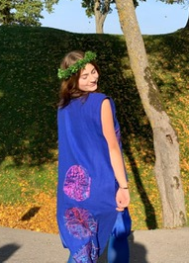
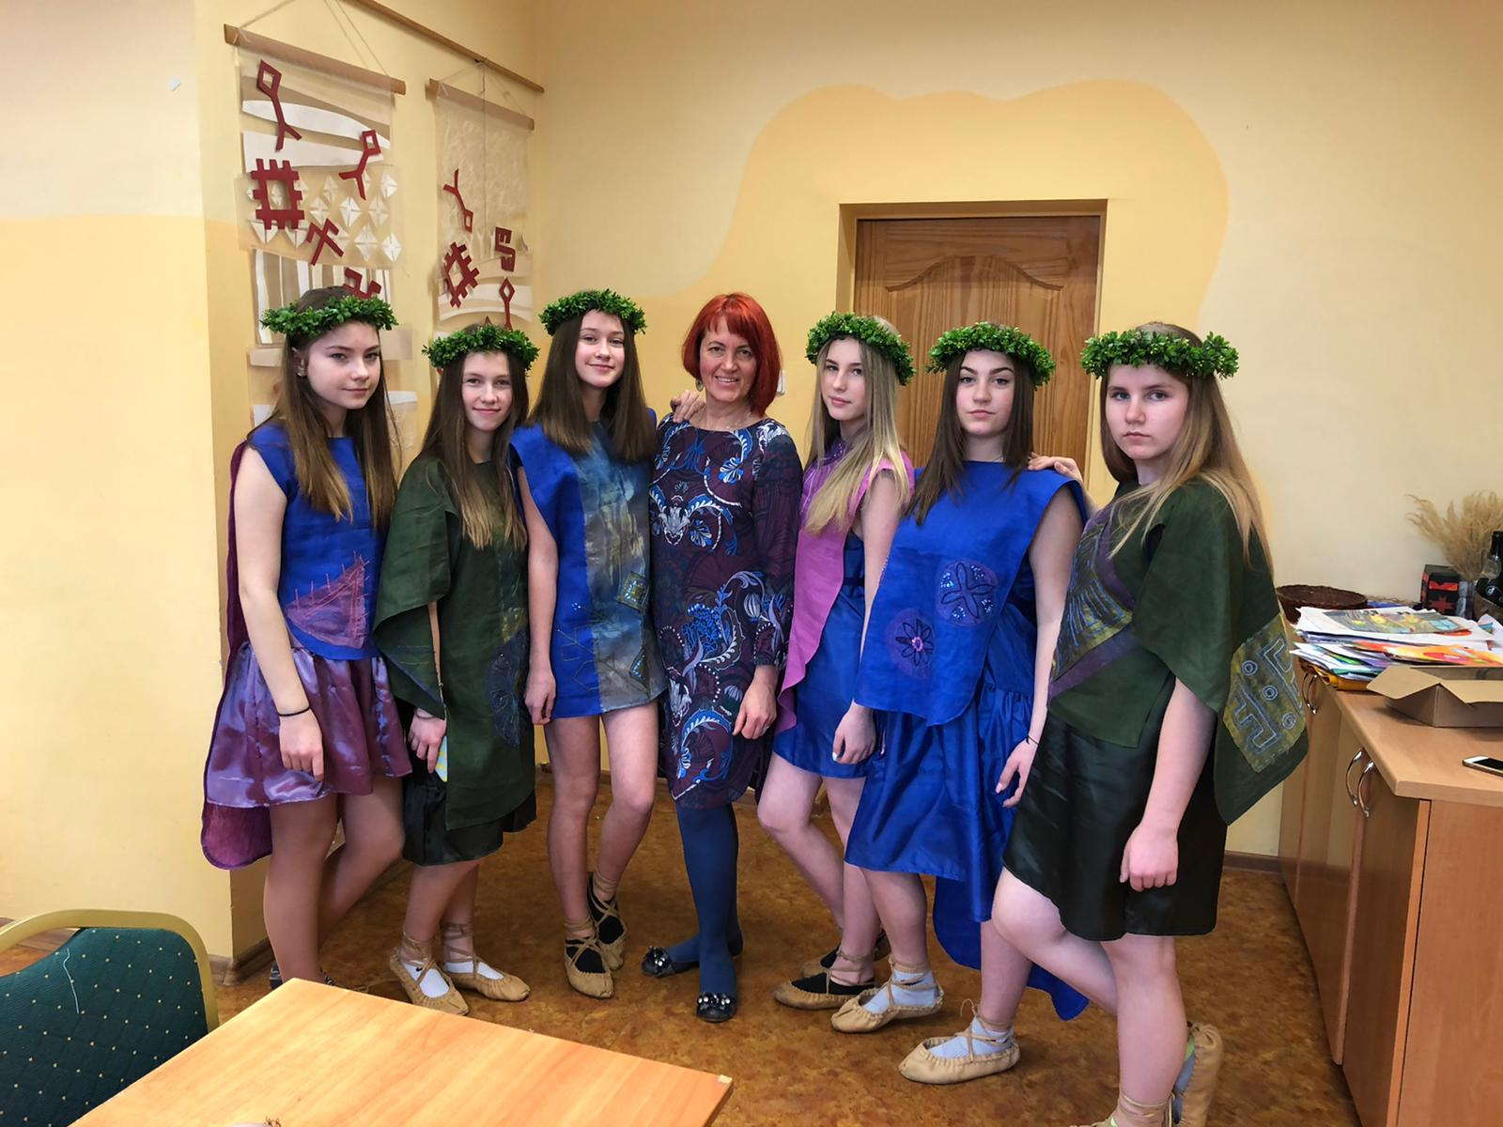

Slide 9
Team information
Teachers involved
Our class teacher Solveiga Gudkova
Students
Marta
Paula
Alise
Lauma

