Slide 1
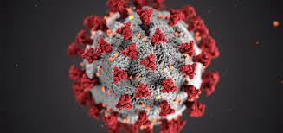
Roberts Untāls un Domeniks Domokejevs, 8.a
Latvia

Slide 2
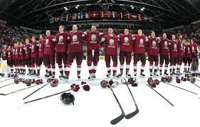
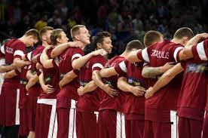
What is our mission and what we have already done.
Our mission is to preserve sports in Latvia during covid-19. We want sport not to be completely abolished in Latvia, but to be restricted. We want to do everything to make sport happen in Latvia again.

Slide 3
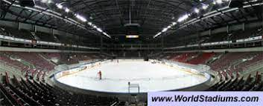
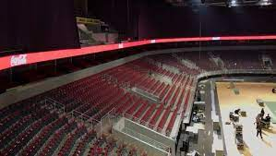
What we plan to do ?
Our idea is to bring sports back to Latvia. To achieve this, we thought of returning all sports only without fans or a limited number of fans. For example, in hockey, fan seats are allowed 2 meters apart. the same would be allowed in football, basketball and other sports.

Slide 4
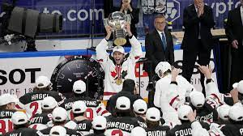
World ice hockey championship 2021
This year, from May 21 to June 6, in Latvia was world ice hockey chamionship. This was a very big event for Latvia, and it is great that during covid-19 we were able to host 16 different countries around the world. No player was infected with the virus throughout the tournament. As the tournament progressed, fans were also able to attend the games according to the rules of covid-19.

