Slide 1
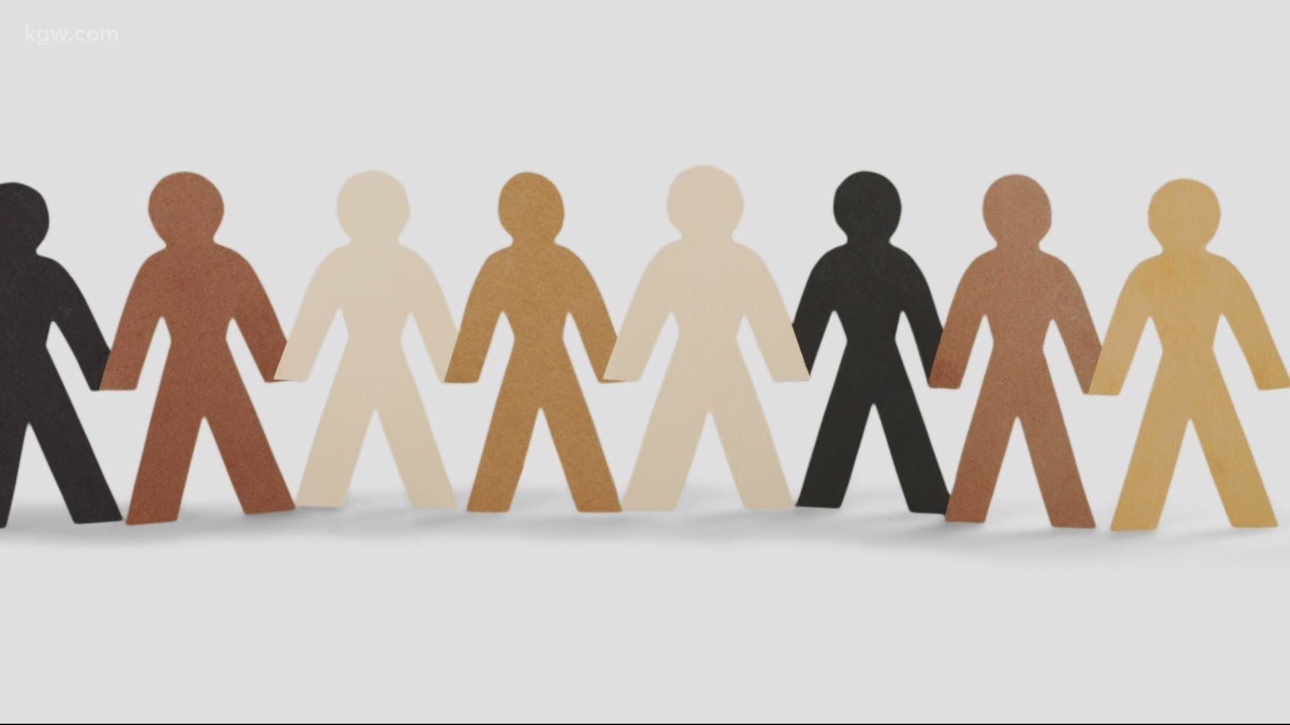
racism

Slide 2
Definition

Slide 3
Example 1
An african person is walking in a convenient store, but the manager who owns it kicks him out saying that he is going to stole just because of his skin color.
In this example the manager is racist.
The belief that somebody is going to do something just because of his race is racism.

Slide 4
Example 2
A vietnam girl is the best student in english class but all the children are saying that she is just cheating because someone from such a poor country can't be that smart.
Believing that some races are not as intelligent as your race is racism.

Slide 5
Example 3
A man is sitting on the bench. In front of him passes a gypsy who has loud music, throws trash on the ground and smokes. A few minutes later another gypsy comes and sits on the bench with him. When the man gets up, his phone drops. The gypsy goes to him and gives him the phone. They become friends, but the man finds out that the person in front of him is of the same race as the one who had just passed. So he said goodbye and left disgusted
When you think that people who live in the same country are the same, you are racist.

Slide 6
THE HISTORY OF RACISM
Racism was at the heart of North American slavery and the colonization and empire-building activities of western Europeans, especially in the 18th century. The idea of race was invented to magnify the differences between people of European origin and those of African descent whose ancestors had been involuntarily enslaved and transported to the Americas. By characterizing Africans and their African American descendants as lesser human beings, the proponents of slavery attempted to justify and maintain the system of exploitation while portraying the United States as a bastion and champion of human freedom, with human rights, democratic institutions, unlimited opportunities, and equality. The contradiction between slavery and the ideology of human equality, accompanying a philosophy of human freedom and dignity, seemed to demand the dehumanization of those enslaved.

Slide 7
By the 19th century, racism had matured and spread around the world. In many countries, leaders began to think of the ethnic components of their own societies, usually religious or language groups, in racial terms and to designate “higher” and “lower” races. Those seen as the low-status races, especially in colonized areas, were exploited for their labour, and discrimination against them became a common pattern in many areas of the world. The expressions and feelings of racial superiority that accompanied colonialism generated resentment and hostility from those who were colonized and exploited, feelings that continued even after independence.

Slide 8
Racism elicits hatred and distrust and precludes any attempt to understand its victims. For that reason, most human societies have concluded that racism is wrong, at least in principle, and social trends have moved away from racism. Many societies have begun to combat racism by raising awareness of racist beliefs and practices and by promoting human understanding in public policies, as does the Universal Declaration of Human Rights, set forth by the United Nations in 1948.

Slide 9
Why is racism a problem?
These days people are not as racist as in the past. But that doesn't mean that everything is fine. A good example is the Black Lives Matter movement. It is a movement that started in 2013 and is still continuing these days. Most of us found about it in 2020 when so many innocent african-american people have been victims of racist people. Some people understood that it is not right but out there, some people still think that being racist is okay.

Slide 10
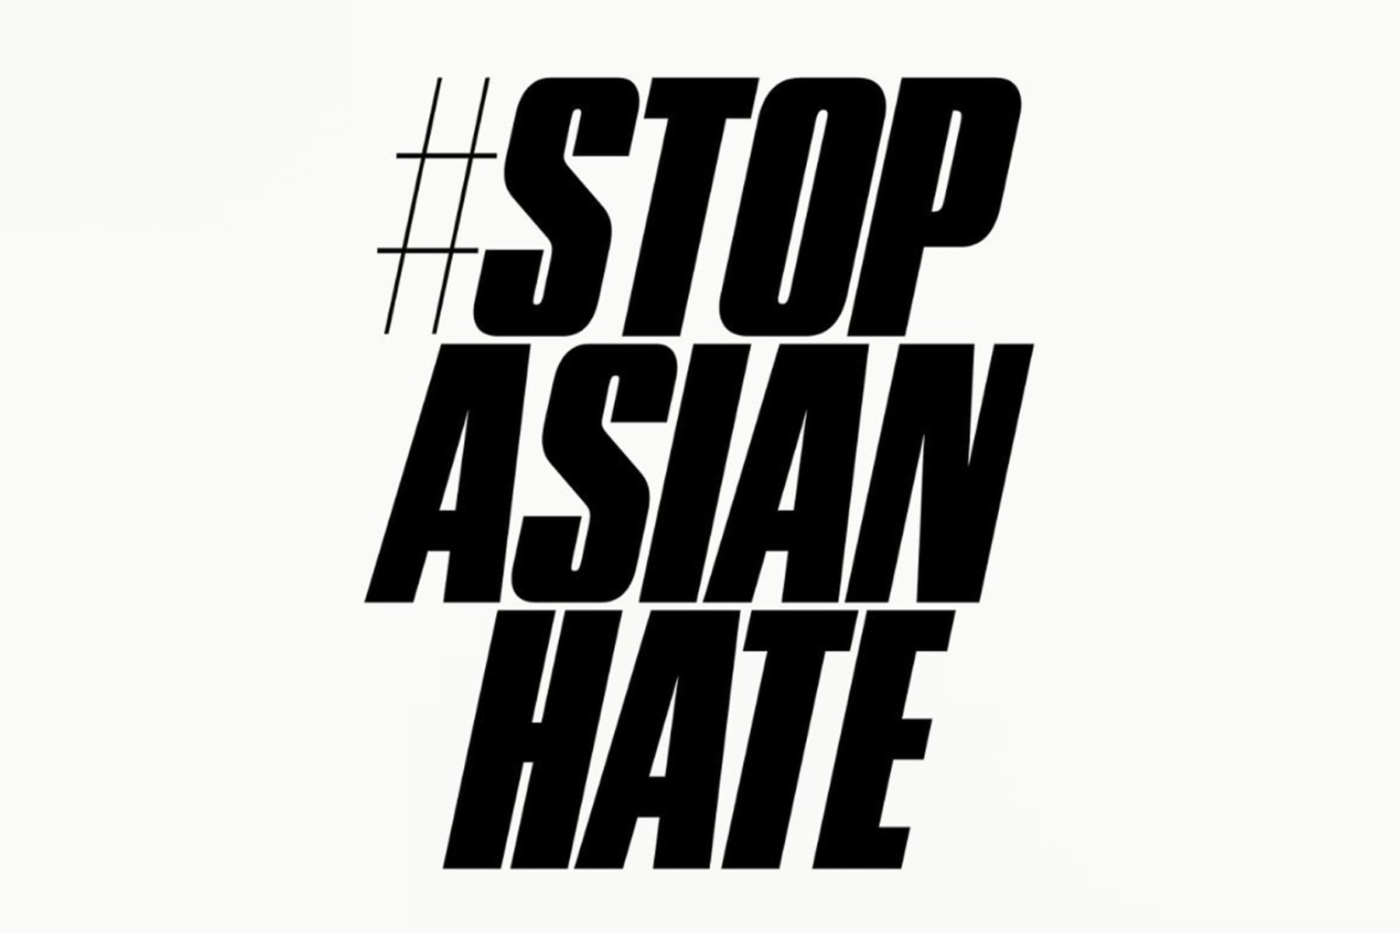
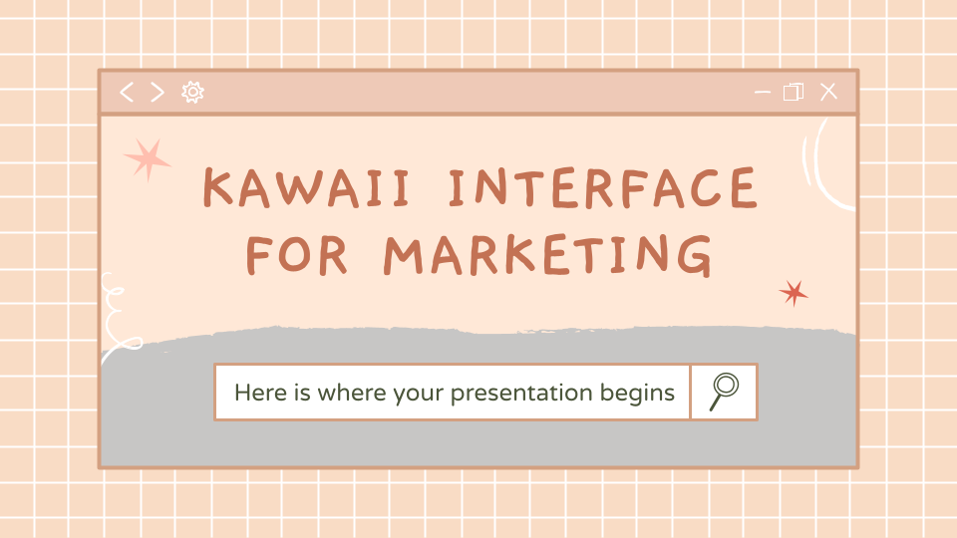
Another good example is the hashtag #StopAsianHate. Since covid, the people hating on asians has increased. It is not their fault for the virus, still there are people who discriminate them just because the virus started in Asia. The asians have always been hated.

Slide 11
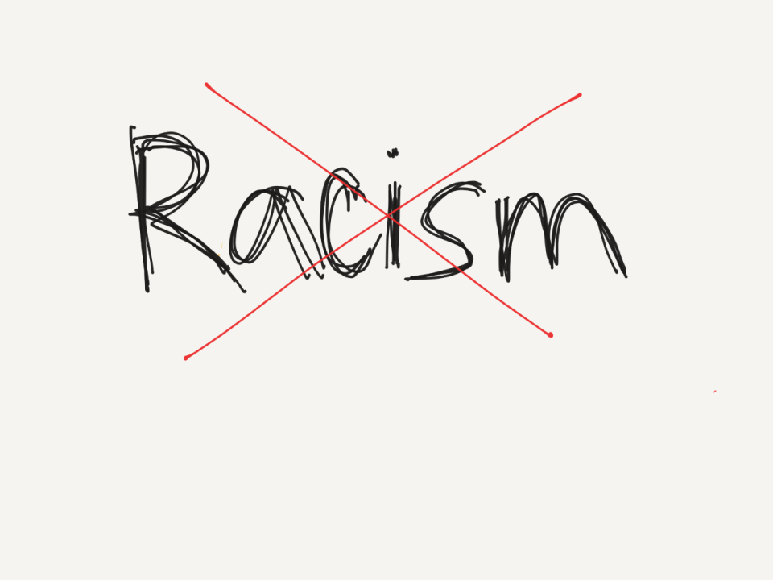
Some people would say that if you are an asian automatically you eat cats or dogs or snakes etc. but since Covid-19 everything went to an extrem. Stop Asian Hate started on 16 Match, 2021, when in Atlanta somebody shooted nine asian people because of his hate for them.

Slide 12
01
WHY DİD WE CHOOSE THİS TOPİC?
Why should we all have to say stop to racist movements?

Slide 13
Because we are all individuals and everyone has rights as human beings. We wanted to address racism, a shame in human history, because we want to show that it is a problem that needs to be solved and that no one is superior to anyone.

Slide 14
“If you are neutral in situations of injustice, you have chosen the side of the oppressor.” – Desmond Tutu
—SOMEONE FAMOUS

Slide 15
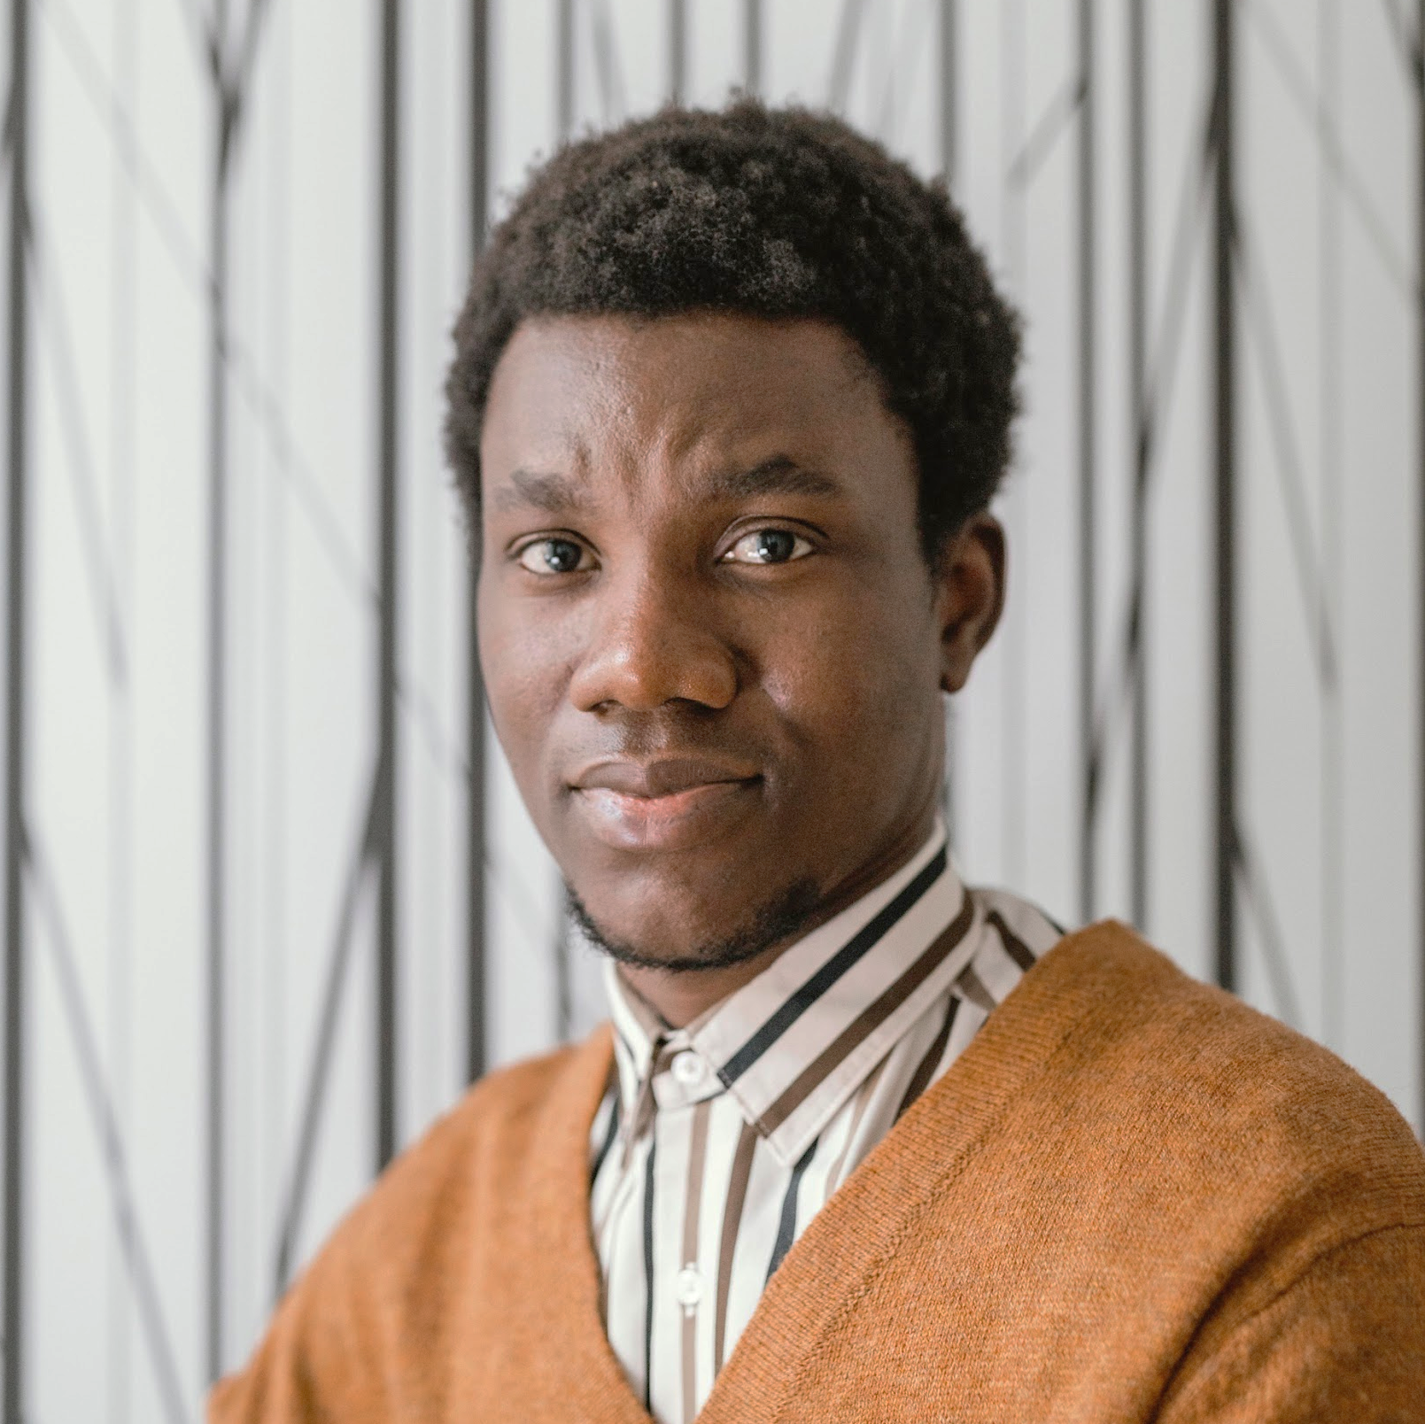
THERE ARE NO DİFFERENCES
TIMMY
JENNA
H
He is black
She is white

Slide 16
02
WHY İS İT WRONG TO BE RACİST?
It is a crime to be racist.

Slide 17
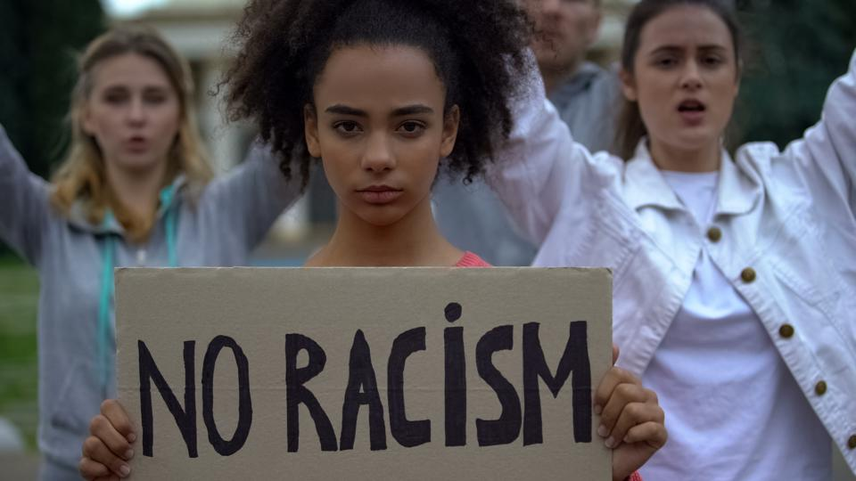

Slide 18
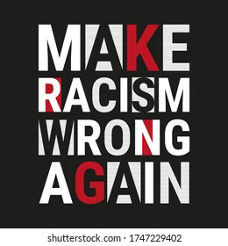
According to world law, a person is committing a 'hate crime' if they direct hostile behaviour at someone based on that person's race and they can face criminal charges.
In 2019, there were almost 80,000 hate crimes globally That's 10% more than the year before.

Slide 19
One of the biggest anti-racism charities is Show Racism the Red Card (SRTRC).
It says the main reason why it's wrong to be racist is because "for the person experiencing racism it can be really damaging to their wellbeing".
Racism is known to cause feelings of sadness, anger and depression.

Slide 20
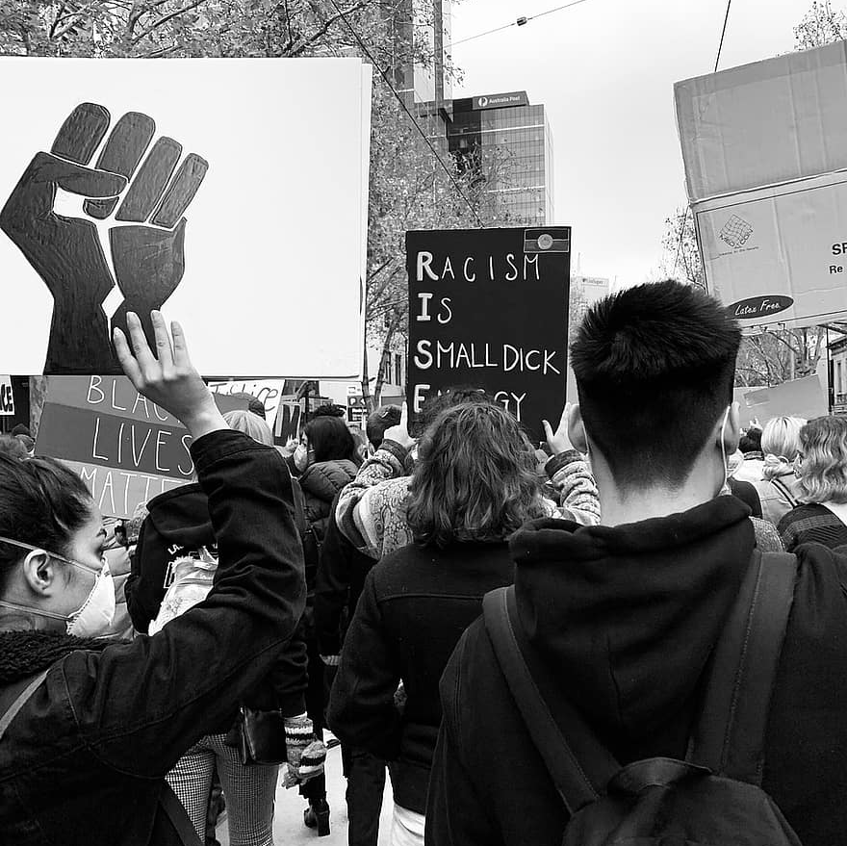
A PICTURE ALWAYS REINFORCES THE CONCEPT
Protesting against racism is one of the steps to avoid it

Slide 21
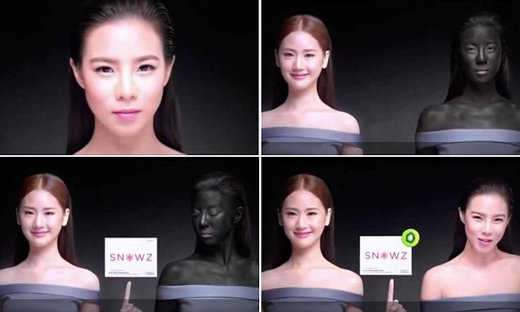

Slide 22
03
SO WHY DO WE WANT TO CHANGE İT DESPİTE WE ARE ONLY FOUR CHILDREN

Slide 23
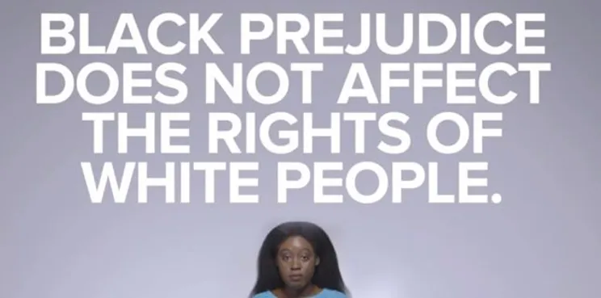
Because we believe that even though we are few people, we can achieve something if we try and we can put an end to this brutal action by making the voices of each of our friends who are suffering from racism heard to other believers.

Slide 24
How did we organise?

Slide 25
How did we organise?
*Law can be enacted
*Explaining racism in the press and media
*Conducting interviews that explain the challenges of racism
*publishing documentaries on the subject

Slide 26
STATİCS

Slide 27
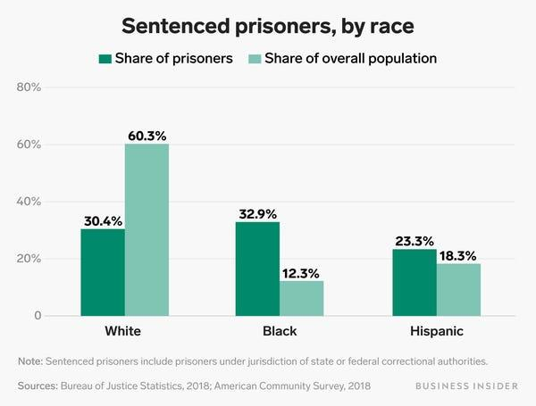
This world is for all of us
50%
50%
WE ALL ARE SAME
50%

Slide 28
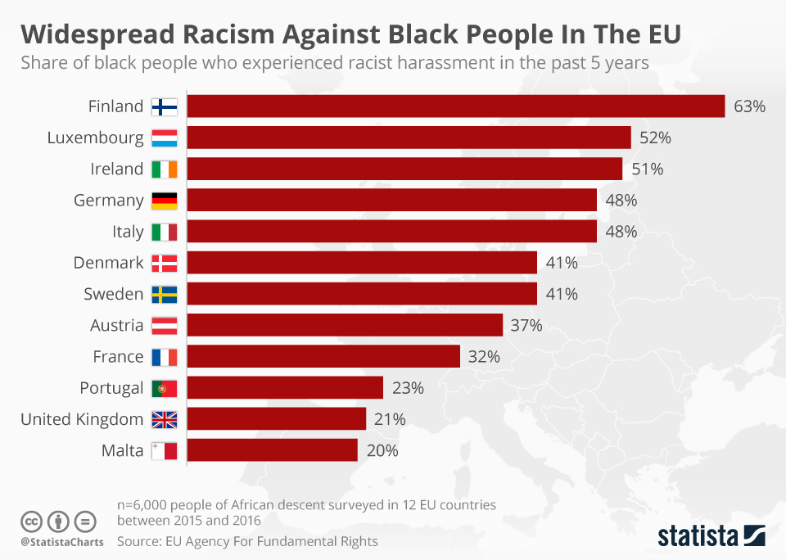
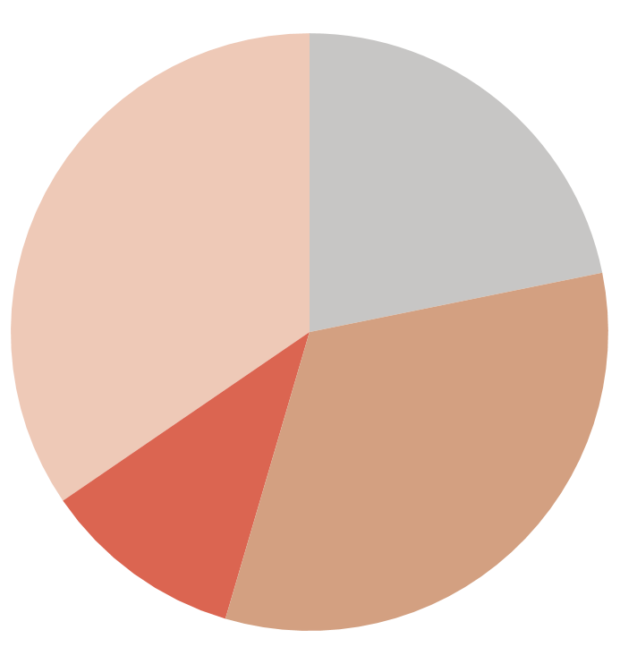
MARKET SEGMENTATION
JUPITER
NEPTUNE
34%
22%
Jupiter is the biggest planet
Neptune is the farthest planet
VENUS
MERCURY
11%
33%
Venus has a lovely name
Mercury is a small planet
To modify this graph, click on it, follow the link, change the data and paste the new graph here, replacing this one

Slide 29
THANK YOU FOR YOUR ATTENTION!
Do you have any questions?

