Slide 1
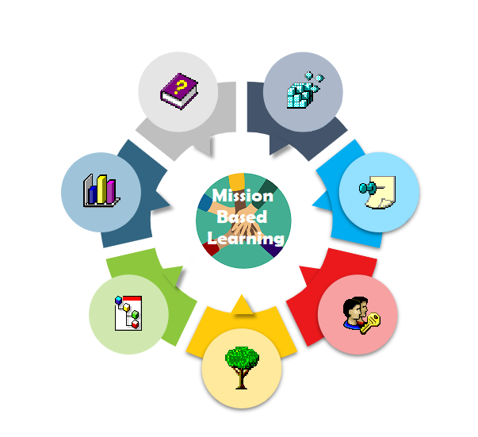
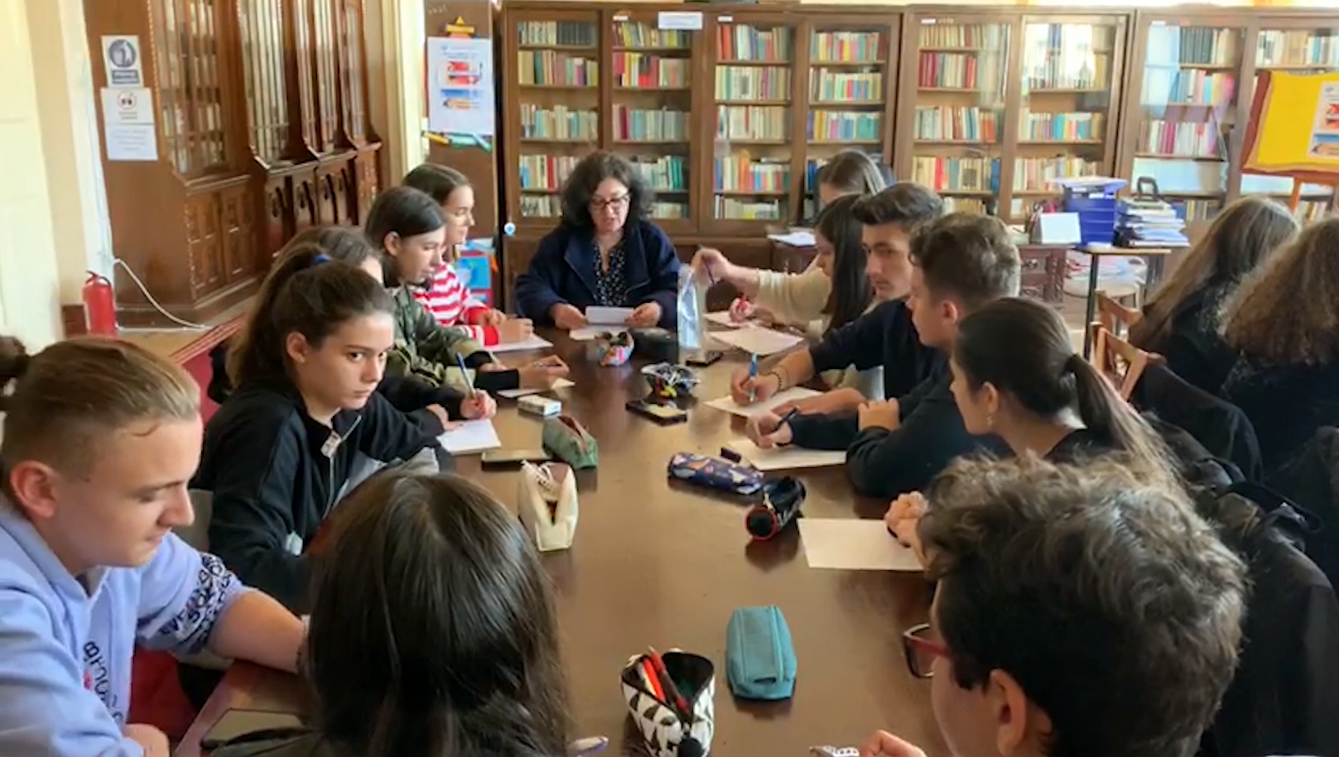
NEWSLETTER- MISSION BASED LEARNING COLEGIUL NATIONAL FRATII BUZESTI ROMANIA
Activities April - June 2021

Slide 2
Completion of the web-site with tourist information about Craiova
https://missionbasedlearni.wixsite.com/website-1

Slide 3
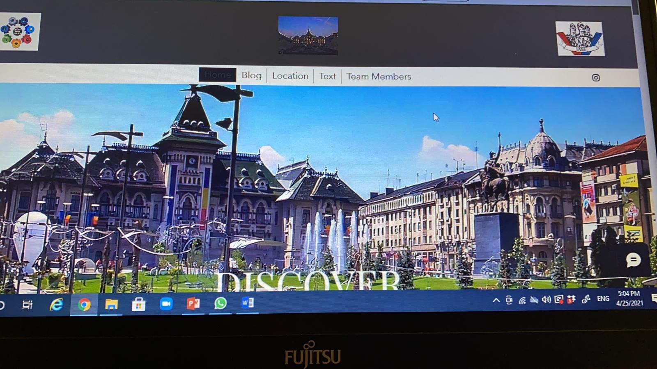
This site was made after a documentation of several months made by the students involved in the project. We believe that this site is extremely useful for the community. It can be used successfully as a tourist guide of the city, especially since it is an initiative that belongs to us.

Slide 4
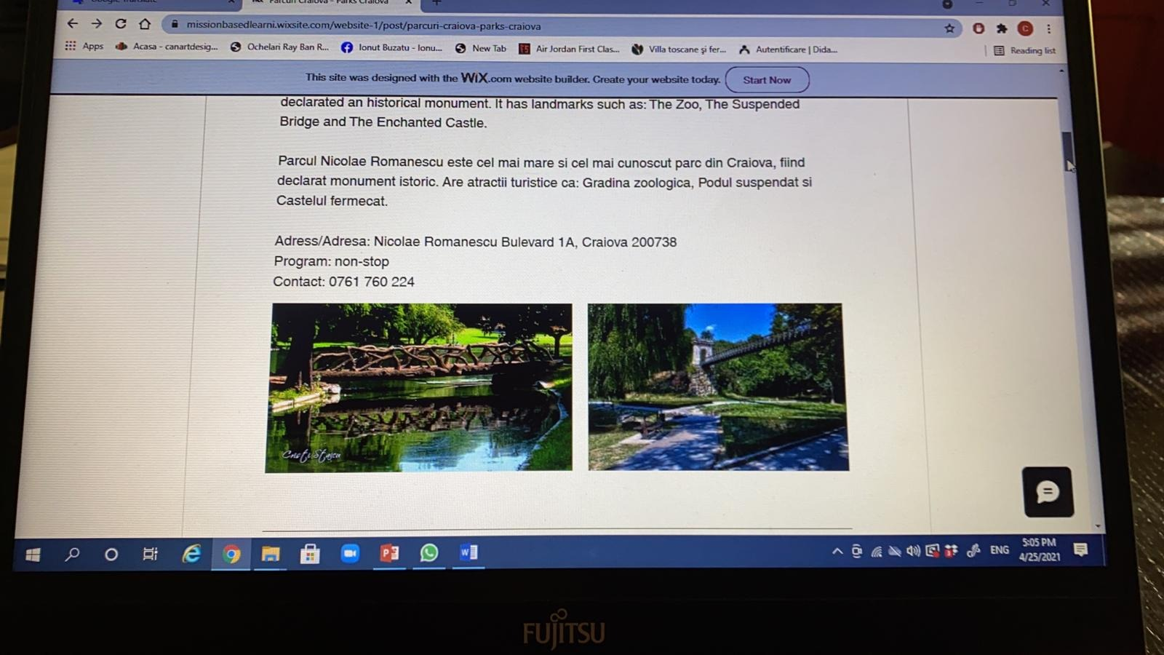

Slide 5
We are now in the phase in which we try to popularize the site made in order to be useful to as many people as possible!

Slide 6
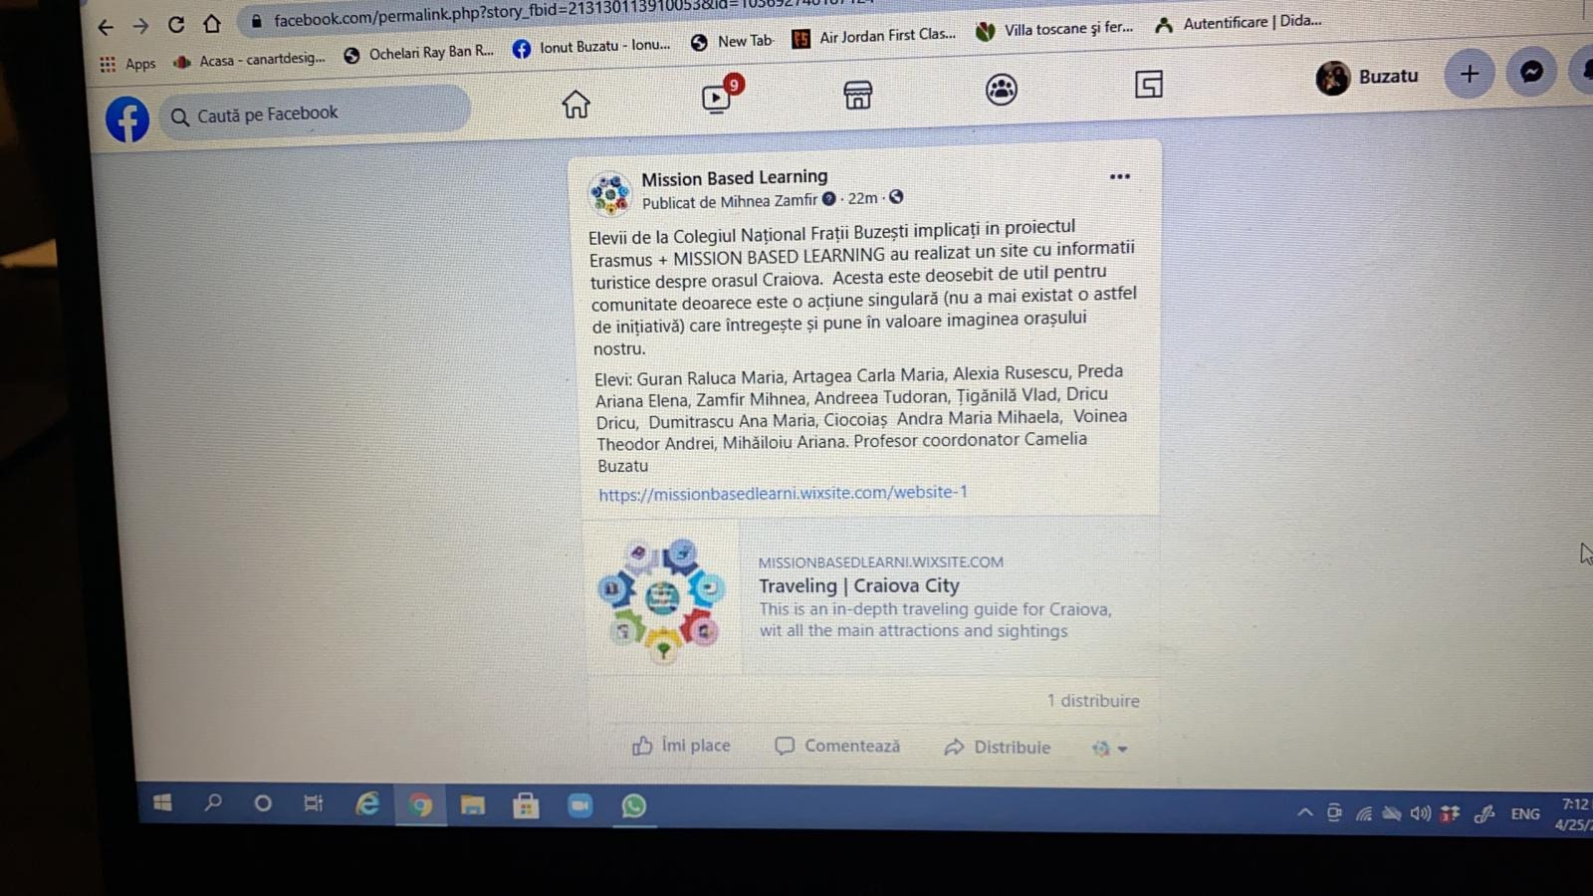
Promotion via facebook
https://www.facebook.com/Mission-Based-Learning-103692748187124/

Slide 7
In order to popularize this tourist site as much as possible, it was created an opinion poll!

Slide 8
1. Do you know anything about the existence of an official presentation site of the city of Craiova?
2. Do you think that the initiative of Buzeșteni students is useful for the community?
3. Do you find the information documented by students interesting?
4. Do you think that this site can be a successful "tourist guide"?
5. Respondent age
6. Sex
7. Studies
8. Do you want to be informed about the results of the survey?

Slide 14
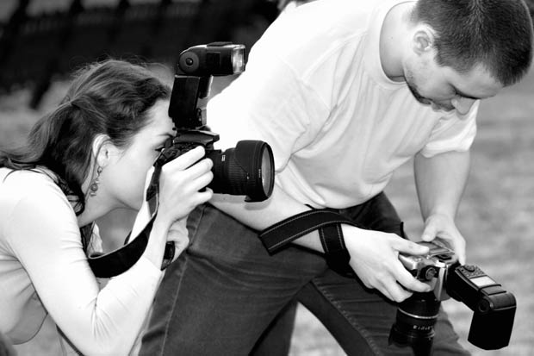
Students: Guran Raluca Maria, Artagea Carla Maria, Alexia Rusescu, Preda Ariana Elena, Zamfir Mihnea, Andreea Tudoran, Țigănilă Vlad, Dricu Dricu, Dumitrascu Ana Maria, Ciocoiaș Andra Maria Mihaela, Voinea Theodor Andrei, Mihăiloiu Ariana. Coordinating teacher Camelia Buzatu and Alina Gae

Slide 15
Meetings between our students and students from other countries
Four 8 | Romania | Theodor Voinea-poluare
 |  | Dricu David- Site
 | Poland | Michał Pauli
 |  | Piotr Połowianiuk
Four 5 | Spain | celia picornell
 |  | julia lago
 | Romania | Vlad Tiganila motivatia in scoala
 |  | Carla Artagea
Four 6 | Romania | Ariana Preda-rasismul
 |  | Maria Guran
 | Turkey | Bilgenaz Dabak
 |  | Atahan Altan
Four 14 | Turkey | Sude Su | 15
 |  | Muhammed Faruk Güler | 15
 | Romania | Andra Ciocoiasi-buling | 15
 |  | Ariana Mihailoiu | 15
Four 7 | Romania | Alexia Rusescu | 15
 |  | Mihnea Zamfir-depresia | 15
 | Poland | Maciej Nawrocki | 14
 |  | Tymoteusz Wójcik | 14
Four 9 | Romania | Andreea Tudoran-feminism | 15
 |  | Ana-Maria Dumitrascu | 15
 | Latvia | Alise Kalderauska | 14
 |  | Lauma Lucaua | 14

Slide 16
The students approached various topics
Motivation in school, racism, youth depression, pollution, feminism, bullying. The topics are very diverse and show the concerns of our students. The topics they researched. They made various materials: PPTX, movies.

Slide 17
Dissemination of project activities
Partnership with the “Tudor Arghezi” High School for the International Conference in order to disseminate the MISSION BASED LEARNING-22.02.2021 project;
Participation in the International Conference “School in Romania and in the world during the COVID pandemic 19. Examples of good practice” with the paper “European Erasmus + projects and IT technology” -01.03.2021;
Participation in the International Symposium “Examples of good practice in preventing and combating violence in schools” 8th Edition, with the paper “Innovation in the teaching-learning process through Erasmus + projects” - 26.03.2021.
Dissemination through the sites created within the project: https://missionbasedlearni.wixsite.com/website-1;
https://missionbasedlearni.wixsite.com/website
Dissemination on facebook: https://www.facebook.com/Mission-Based-Learning-103692748187124/
Dissemination via the internet: www.cnfb.ro.

Slide 18
Making four newsletters

