Slide 1
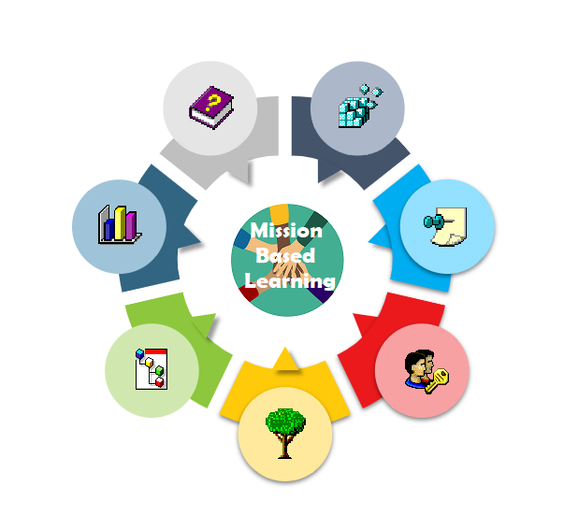
Mission-Based Learning Sports in COVID-19 limitations
Bauskas pilsētas pamatskola
Put flags here

Slide 2
The story so far…
Background: We discussed how this affects us, our sport interests and trainings. We theorised about what could be done better and what is just right.
We learned a lot from our own expieriences, family and community. Information about the current rules we got from https://covid19.gov.lv
A big help were our teachers too!

Slide 3
What actually happened…
Planning your missions: The people participating in this project from our school, divided into two groups, our team is investigating rules around sports during COVID-19. The other team is investigating fashion and self identity.
Challenges: Giving that it’s the last year of middle school for us, we were challenged to find extra time for researching. There are so many things for school that we must do before this. Another struggle is the constantly changing rules and situation around and about COVID-19.

Slide 4
Our expieriences
At the beginning of November I had 2 hockey camps in a row in two different Lithuanian cities. The first camp took place in Kaunas and I didn't have any problems to get there, because I am vaccinated. The camp went well. Two days of the camp, we had pool lessons where everyone could swim freely, including the unvaccinated. Everything went well in Kaunas and no one had any problems being without a covid certificate. Everything was good in the second camp too, which took place in Elektrėnai, and unvaccinated people also took part in it. In Elektrenai we only had ice training every day.
I play checkers and have participated in tournaments in Latvia and abroad. In Latvia, the Covid test must be done 48 hours before the tournament. No masks needed in the game room, but it was imperative to be worn outside the game room. That was during the summer in Latvia. When I drove to the world championship, which happened in Bulgaria. The tests were only needed for border crossings. On the last day of the tournament, masks had to be worn in the game room as the country's COVID-19 situation. When I returned to Latvia, I had to quarantine. I returned in Latvia September 1st. And during the quarantine, I figured to take a COVID-19 test, that turned out to be positive. I wasn't able to go to school for 3 weeks and it was hard to learn and study at home.

Slide 5
Storyline
Gathering up all of our carifying our reasearched information
The start of quarantine
Enjoying the summer
Filming a video about online school struggles
April 2021 | May | June | July | Aug | Sept | Oct 2021
Figuring out what we want this project to be, look like etc.
Reinis’ checkers tournament

Slide 6
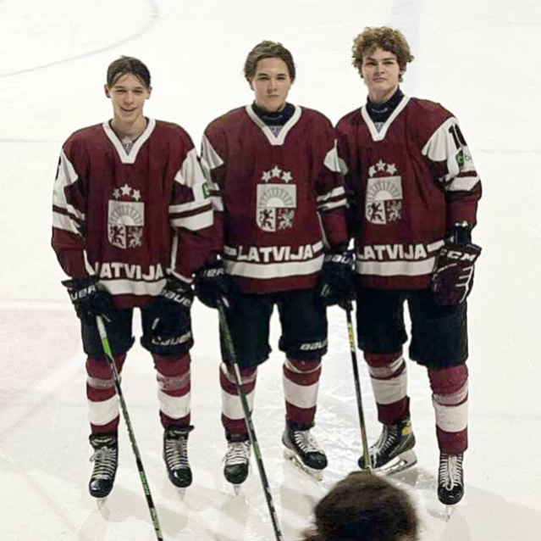
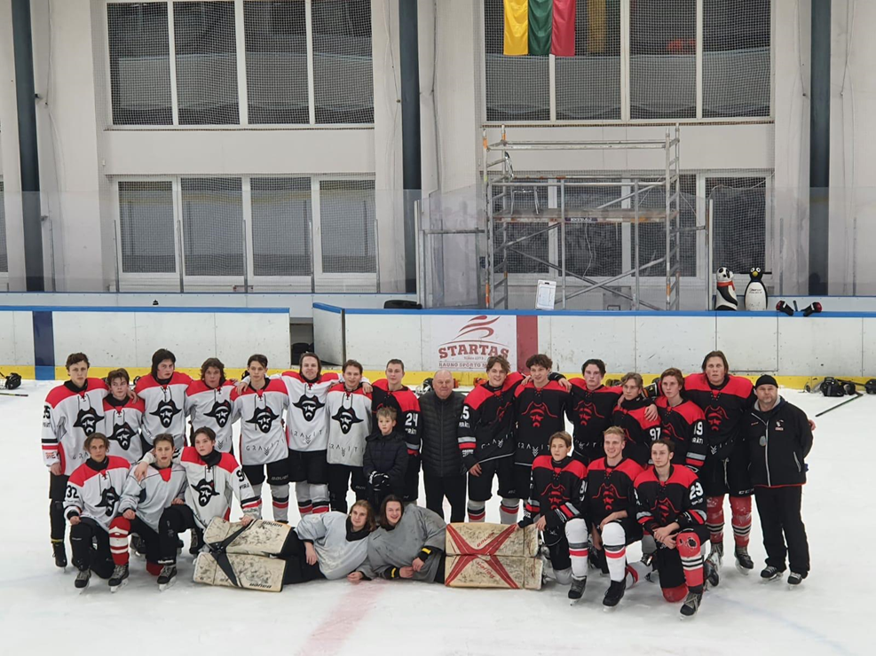
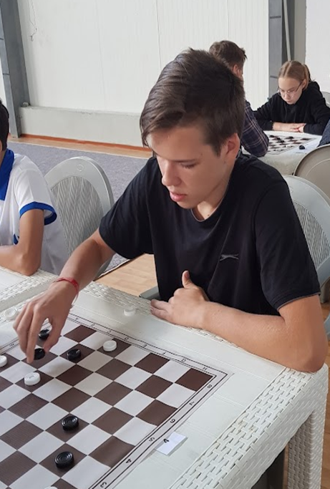
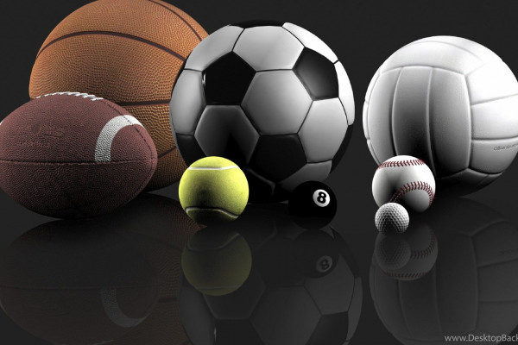
In these photos you can see us participating in different sports and activities.

Slide 7
Project results: Physical & social changes
As a result of us ourselves learning about these restrictions and rules we could simplify them for an easier every day life..
All the people involved got more comfortable with the rules and accepted that they are actually there to help us even when we don’t believe that ourselves. As we grew to understand, we thought of ways how to still enjoy sports in not so conventional ways.

Slide 8
Project results: Learning
As a result of getting comfortable with the rules…
We learned that, everything can change within a day, so we have to stay adaptable. We also learned that we have to be open minded and stay aware.

Slide 9
Project results: impacts
As a result of everything adding up...
With us will stay the abillity to think outside the box in stranded situations, and we hope we inspire people with our hopefullness to try and achieve more and more. We also hope that by expieriencing the quarantining, social distancing etc. together we get a better eduction, more of it hands on, because we all agree on one thing - online school was difficult.

Slide 10
What people said about it
What made this project so special for them?
“ This project was special to me, because I play a lot of sports and I think it’s an important part of growing up. I feel hopeful while researching ways to still participate in them while fighting COVID-19 as a community.
”
“ I’m happy that online school has opened up new ways of learning to care for your own health to be honest, it’s sometimes good to look on the positive side of things
”
“ Seeing my students be passionate about things that are important to them makes things look a lot brighter in the far, faraway future.
”

Slide 11
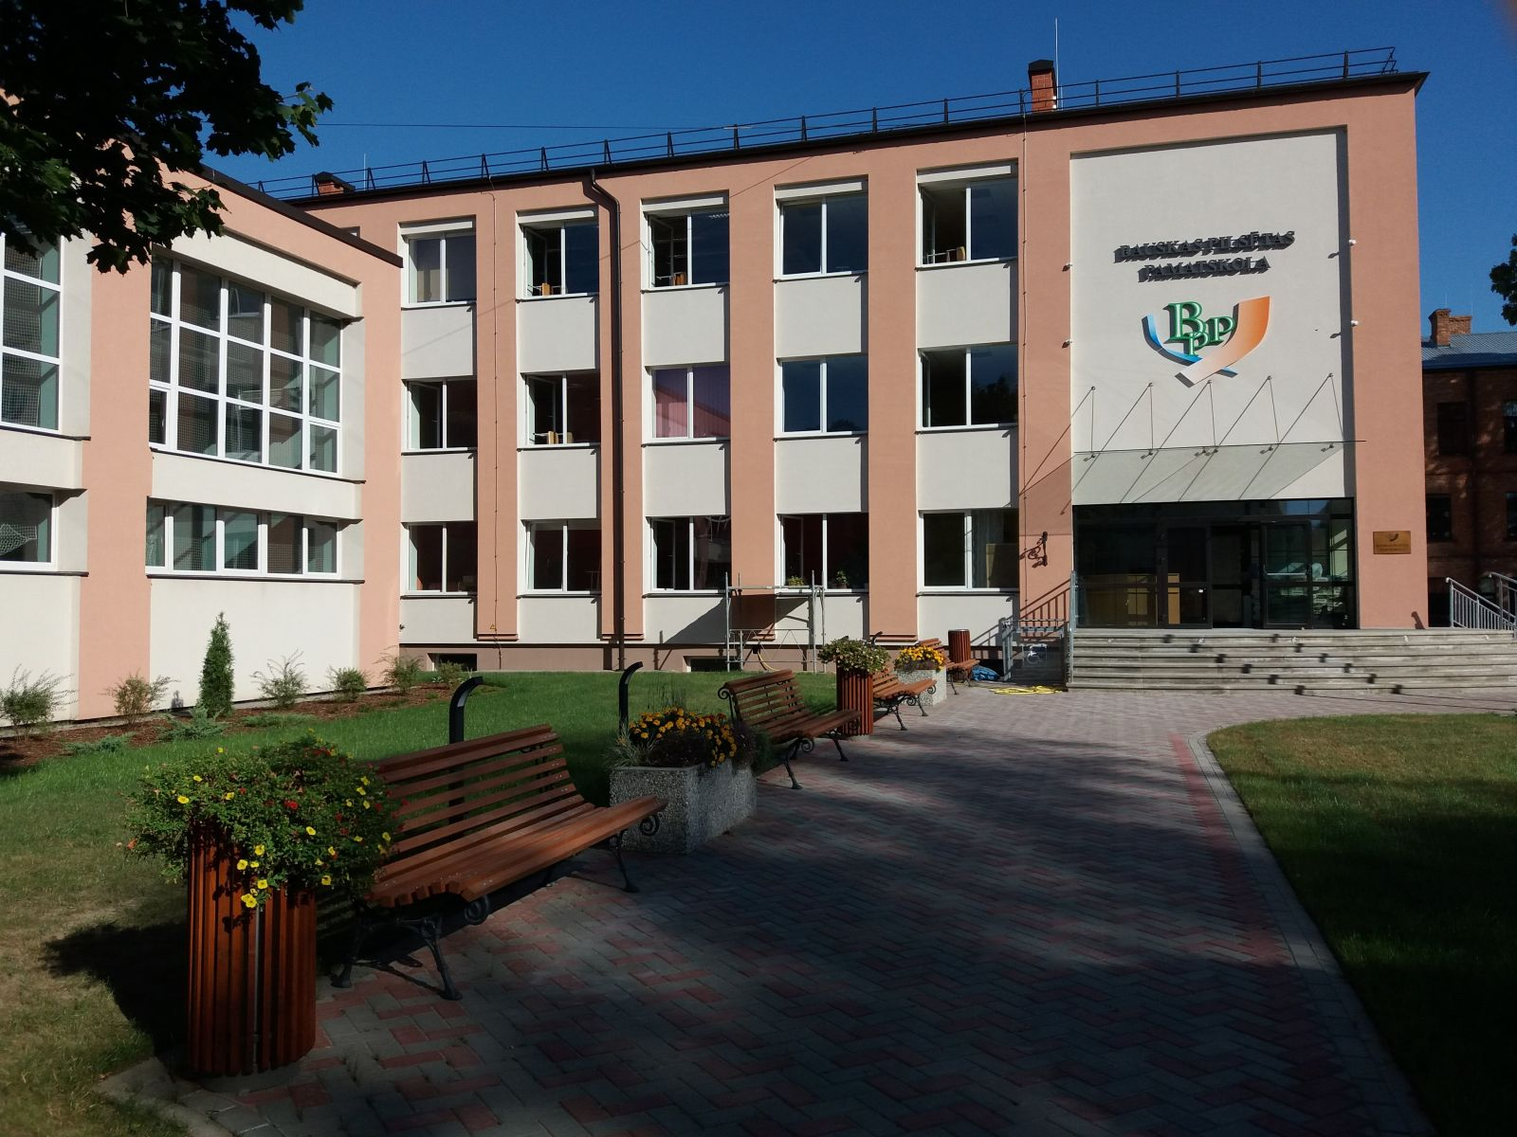
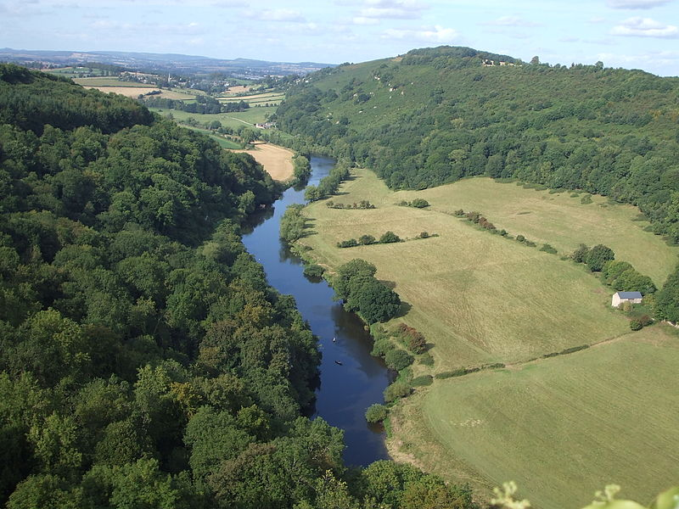
Team information
Teachers involved
Solveiga Gudkova
Students
Domeniks Domokejevs
Reinis Štāls
Lauma Lucaua
Community partners
Schoolmates, classmates and our sports teammates.
References to literature & other resources
Please replace image with your own photos/artwork
References to literature & other resources
https://covid19.gov.lv

