Slide 1
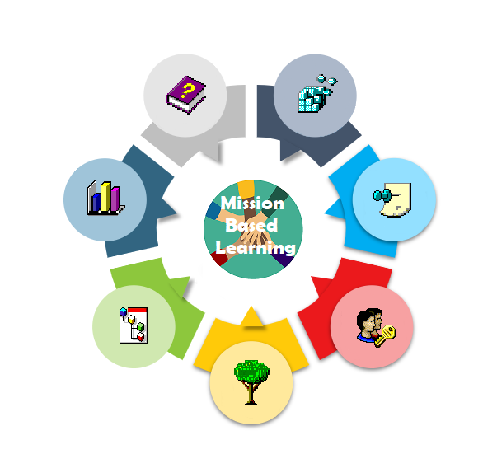
MBL Sue Ryder School Poland

Slide 2
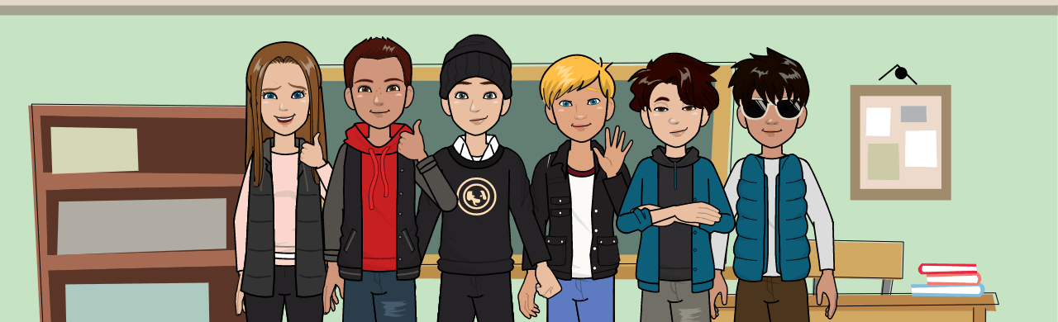
The Team

Slide 3
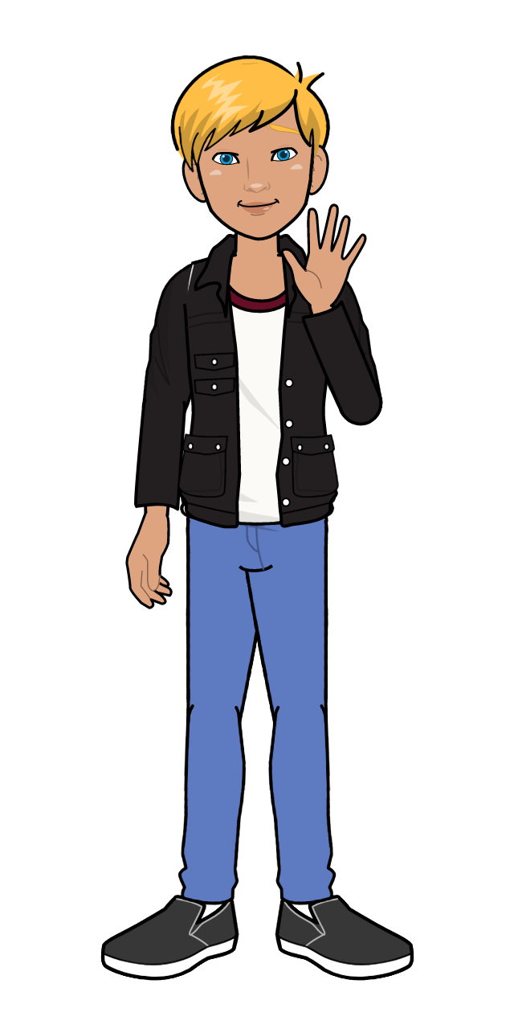
Michał

Slide 4
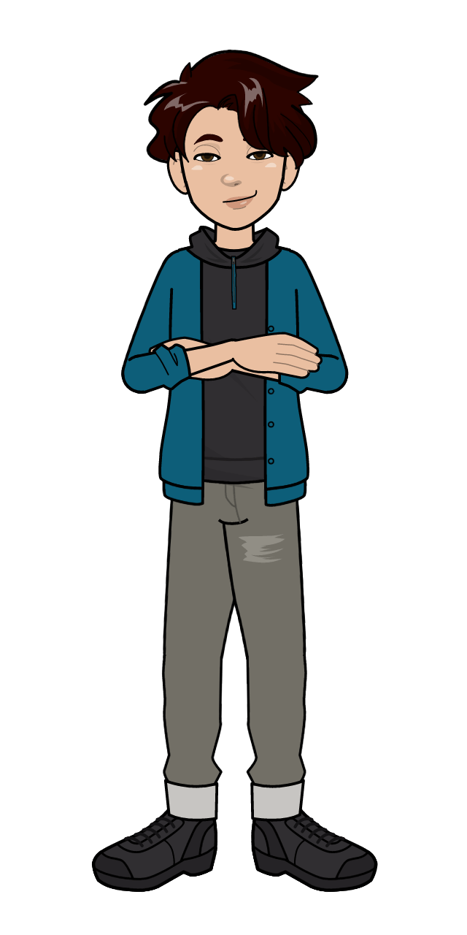
Tymek

Slide 5
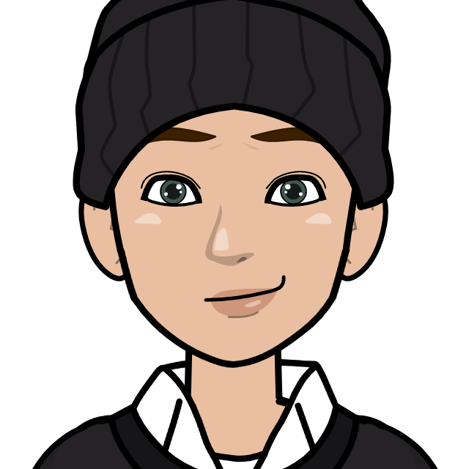
Maciek

Slide 6
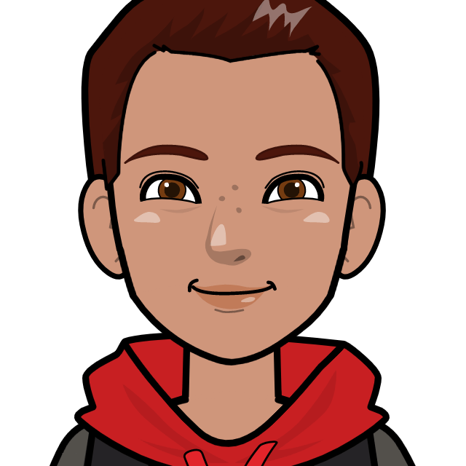
Bartek

Slide 7
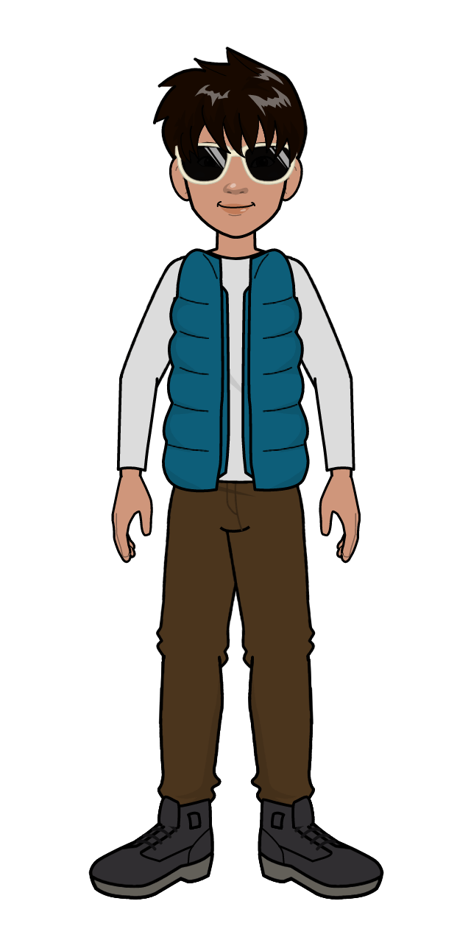
Piotrek

Slide 8
The mission
We want to make people think about air pollution
Some people in our community burn rubbish in the home furnaces.
We want to tell them to reduce their waste and not to burn rubbish

Slide 9
What we did?
1 Michał went to the UK to find out about the missions.
2. we met and we used brainstorming to get some ideas
3 we chose the topic that deals with ecology.
4. we wanted to tell people that burning rubbish is dangerous
5.we had 2 meetings with specialists about that subject and a deep conversation
6. we created posters to promote the campaign
7 and made a short film

Slide 10
Next steps
we would like to share our thoughts with our schoolmates at their classes next month

Slide 11
Work in international teams
Four 1 (Poland+Spain)
Four 7 (Poland+Romania)
Four 8 (Poland+Romania)

Slide 12
difficulties
LOCKDOWN AND WORKING ONLINE
MOTIVATION TO WORK
GETTING THE RIGHT TIME TO MEET ONLINE FOR EVERYONE
LANGUAGE SKILLS
LACK OF CONFIDENCE WHILE SPEAKING LIVE

Slide 13
Thank you, Let’s watch a short video

